Slide 1
Power up your PowerApps!
SharePoint Saturday Netherlands 2019

Slide 3
About me
Functional Consultant
SharePoint, PowerApps & Flow enthusiast
#PowerAddict
Blogger
@rik_koning
rikdekoning
rdekoning@portiva.nl
https://about365.nl

Slide 4
I won’t be covering
PowerApps basics
CDS
Model Driven Apps
Custom code

Slide 5
Agenda
Usability
Pre-build stage
Accessibility
Design
Manageability
Language and locale
Naming convention
Design
Re-use
Business logic
Sharing/permissions
Documentation, testing and backup

Slide 6
Usabilty
In the end, the end user decides if your PowerApp is worthy of his/her time.
E = Q x a
Effectiveness = Quality x Acceptance

Slide 7
Pre-build stage
Make sure to include the end users and/or stakeholders during pre-build stage to make sure the PowerApp will be accepted.
Workshops
Data modelling
Wireframing
…

Slide 8
Accessibility
Screen naming
Use of colors
Multimedia
Captions
Transcripts
App checker
Notes:
Screen readers read out screen names
Determine if there might be visually and/or hearing impaired users
Adjust color use > COlor BLIndness Simulator > http://www.color-blindness.com/coblis-color-blindness-simulator/
Use captions (ClosedCaptionsUrl)/transcripts (through Label or AccessibleLabel)
App checker helps you with accessibility issues

Slide 9
Accessibility properties
AccessibleLabel
Live
Off
Polite
Assertive
TabIndex
Notes:
AccessibleLabel
Used by screen readers to read out visual controls (image, icon, shape, etc.)
Live
Used by screen readers to read out changes to content (only in a Label control)
Off: no announcement
Polite: finished announcement while other changes are made
Assertive: interrupts announcement while other changes are made
TabIndex
Keyboard navigation (tab order) based on X, Y coordinates. -1 skips the control (e.g. images, icons, shapes)
The higher the number, the later it will be navigated to

Slide 10
Design
Orientation
Phone
Tablet
Screen size
Responsiveness
Branding
Notes:
Determine which device is used most and adjust your PowerApp to that format. When changing format/size your controls will be auto resized by PowerApps! > DEMO
Responsiveness is possible, but also a lot of work
Choose a branding that your users can relate to (company branding)
Add ?hidenavbar=true to your PowerApp URL to hide the suitebar

Slide 11
Manageability
Having a great usable app doesn’t mean it’s easy to manage
Make sure you set design agreements across your ‘development’ team
Everyone does everything in a different way
You’re probably not the only one managing the PowerApp
Your way may not be as obvious to others

Slide 12
Language and locale
English browser / Office 365 language
Function syntax
Seperators
Notes:
If you need to Google something, you’ll be getting most results with English naming
Controls
Errors
…
Copy-pasting examples from internet into another locale will most likely result in errors
English
parameter separator: comma (,)
Function separator: semicolor (;)
Decimal: dot (.)
Dutch
Parameter separator: semicolor (;)
Function separator: double semicolor (;;)
Decimal: comma (,)

Slide 13
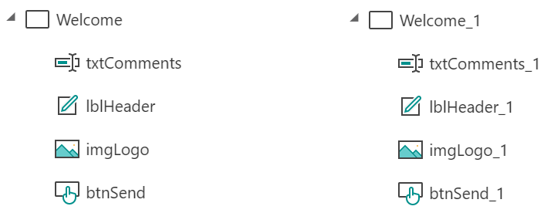
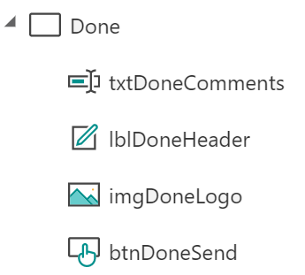
Naming convention
Prefix
Avoid xx_1 naming
copy
Notes:
Choose a prefix that suits you and your coworkers. There are no hard guidelines .

Slide 14
Design
Single point of entry
First screen (visible)
Config screen (invisible)
Dependency
Coordinates, Size, Text, Color, etc.
Images
Integrated
External

Slide 15
Re-use
Copy-paste across screens/apps
Components!
Notes:
You can copy (a set of) controls directly
Within your app by using CTRL-C > CTRL-V or right-click > Copy/Paste
Between apps by using CTRL-C > CTRL-V
When screen is selected, all controls will be copied
Coordinates will most likely change after copy-paste action
Components are defined once and can then be used across your PowerApp. Changes made in the component will automatically be pushed throughout your PowerApp
You can use Custom Properties to set Control values in your Component (input property) or to set Control values in your PowerApp (output properties)
Input properties are set in your PowerApp on the Component properties
Output properties are set in your Compenent on Advanced Properties

Slide 16
Business logic
Try to avoid implementing complex business logic directly into your PowerApps. Flow is a much better tool for this!
Auto format functions
App checker

Slide 17
Sharing/Permissions
Multiple owners
Service account
Individual / Organizational
Notes:
Is your PowerApp meant for everyone in your organization or only for a specific set of users (individual/security group)?
Make sure there are multiple owners so that there is always a backup
If possible, create a service account that is owner on all your PowerApps/Flows. Grant the correct permissions/licenses to this account

Slide 18
Documentation, testing and backup
Testing
Backup
Version history
Export
Documentation
Design documents
Comments
Notes:
Documentation
Technical/functional design/wireframes
Comments can be used in your PowerApp functions by using //. Make sure not to comment out function separators!
Testing
Various scenarios
Various permissions
Various user types
Make sure to include the end-user as well!
Version history does not show comments (even if it has the column available) so it becomes unclear after a while. Export your PowerApp after a (major/published/…) update and store it somewhere when you also store comments on the version (e.g. SharePoint)

Slide 19
DPAFUG – Ask The Experts
@DPAFUG

Slide 20
Thanks for attending
@rik_koning
https://about365.nl

Slide 22
Resources
https://docs.microsoft.com/en-us/powerapps/maker/canvas-apps/accessible-apps
https://docs.microsoft.com/en-us/powerapps/maker/canvas-apps/create-responsive-layout

